Slide 1
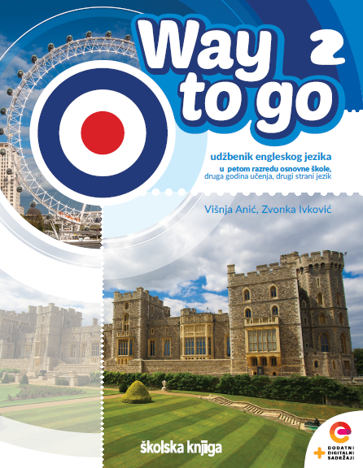

UNIT 5: Me and the World
Our world

Slide 2

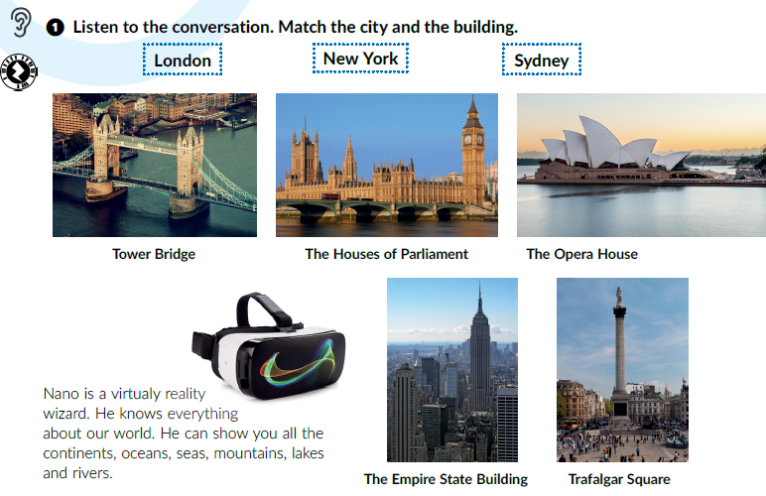

Click on the following link and choose Play and learn: Around the world.
https://www.e-sfera.hr/dodatni-digitalni-sadrzaji/ce4c09a8-36ff-4ccb-ae40-ca4be1107d40/
Listen and match the city and the building.
Who is Nano?
Sydney
London
London
New York
London

Slide 3
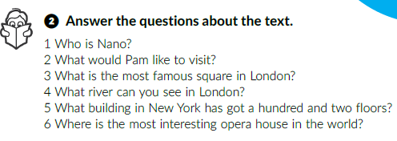
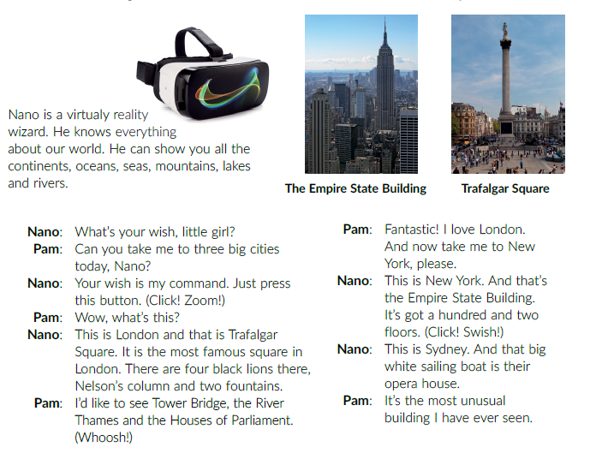
Listen again and underline the words related to geography (e.g. river, London…)
Work in pairs and answer the questions.
1 Nano is a virtual reality wizard.
2 Pam would like to visit three big cities.
3 Trafalgar Square is the most famous square in London.
4 You can see the River Thames.
5 The Empire State Building has got 102 floors.
6 The Sydney Opera House is the most interesting opera house in the world.
Read the text out loud.

Slide 4
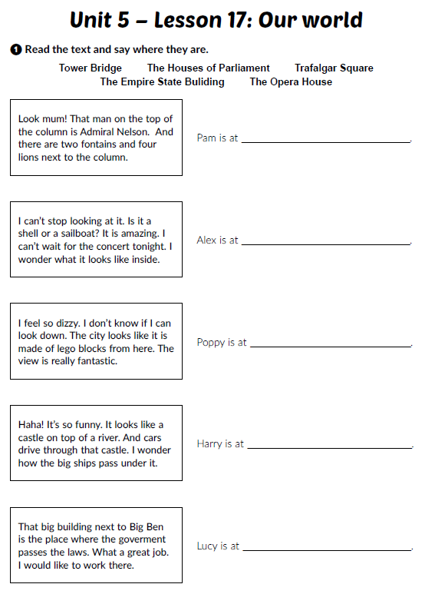
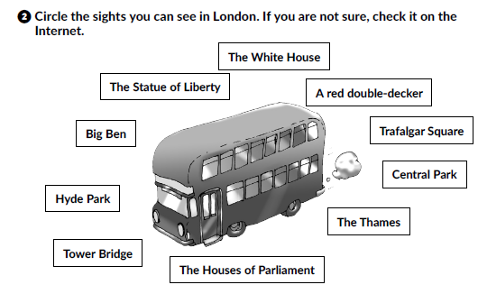
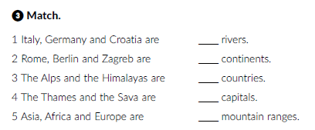
Workbook, p. 67-68
Trafalgar Square
the Opera House
The Empire State Building
Tower Bridge
4
5
1
the Houses of Parliament
2
3

Slide 5
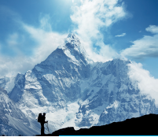
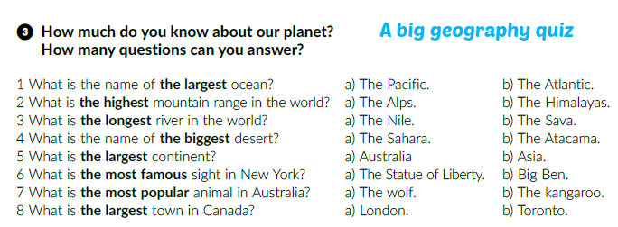
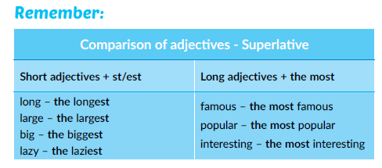
Click on the following link and choose Learn more: Geography quiz.
Do the quiz and answer the questions.
https://www.e-sfera.hr/dodatni-digitalni-sadrzaji/ce4c09a8-36ff-4ccb-ae40-ca4be1107d40/
Textbook, p. 95
What type of words are the words in bold?
Is this a comparative form of the adjectives?
Adjectives.
No.

Slide 6
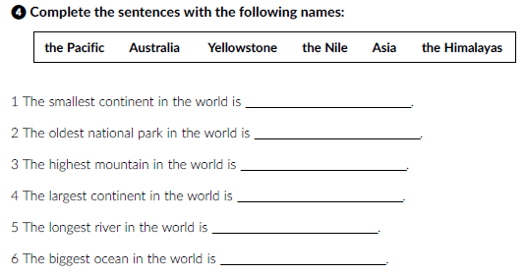
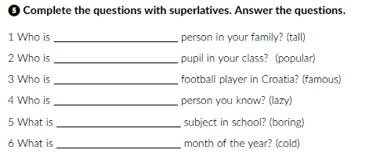
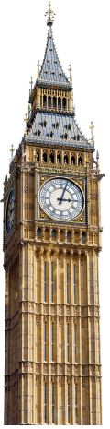
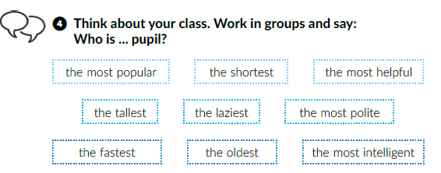
Workbook, pages 68-69
the tallest
the most popular
Australia
the most famous
Yellowstone
the laziest
the Himalayas
Asia
the most boring
the Nile
the coldest
the Pacific
Click on the following link and choose Learn and more: Seven new wonders of the world.
https://www.e-sfera.hr/dodatni-digitalni-sadrzaji/ce4c09a8-36ff-4ccb-ae40-ca4be1107d40/
Which of these places would you like to visit? Why?
Answer the questions below the text and write about a wonder in Croatia?
Open your book at page 95.
Work in groups.

Slide 7
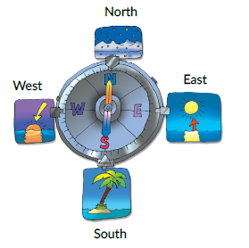
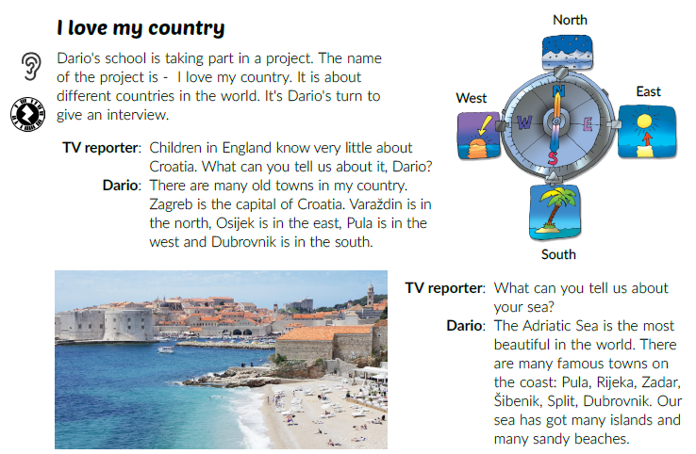
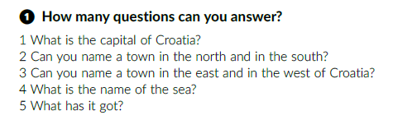
Click on the following link and open the PowerPoint The wonders of my country and do the quiz.
https://www.e-sfera.hr/udzbenicke-serije/podrska/daf7bd10-1bcb-47bf-948c-893bad7d56d3
Textbook, p. 96
Where is north / east / south / west in your classroom?
Listen and underline cities in Croatia.
Listen and answer the questions.
1 Zagreb is the capital of Croatia.
2 Varaždin is in the north and Dubrovnik is in the south.
3 Osijek is in the east and Pula is in the west.
4 The name of the Sea is the Adriatic Sea.
5 It has got many islands and sandy beaches.

Slide 8
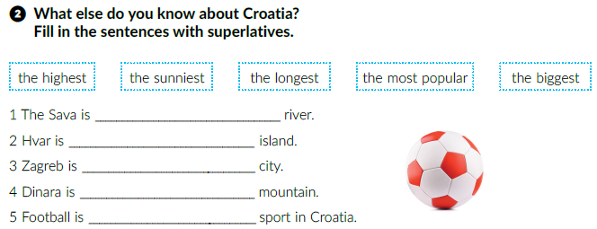
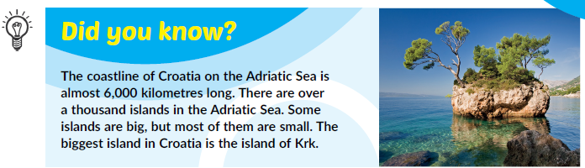
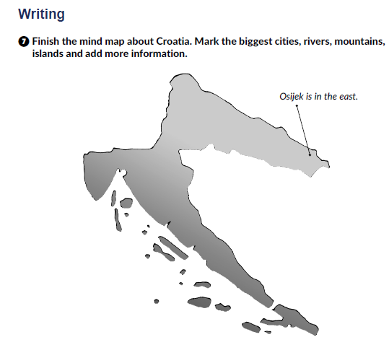
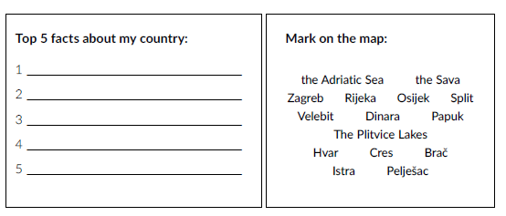
the longest
the sunniest
the biggest
the highest
the most popular
Workbook, page 70

Slide 9
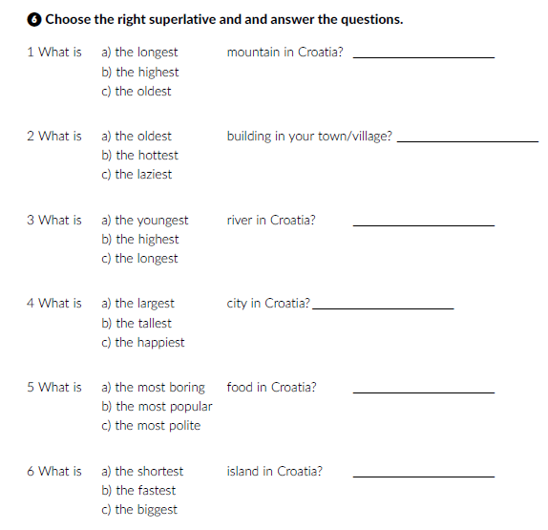
workbook, p. 69
Read the text out loud.
Dinara
Sava
Zagreb
Cres

Slide 10
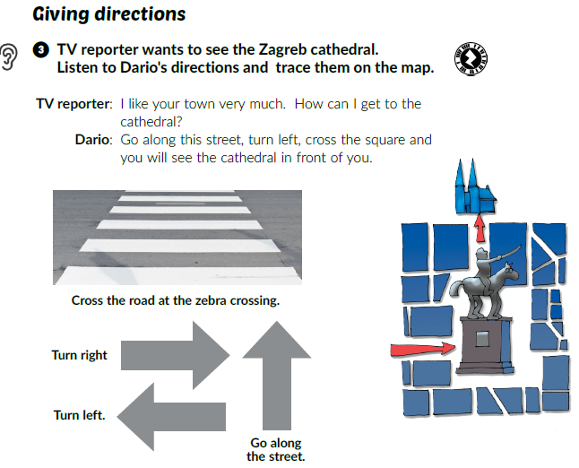
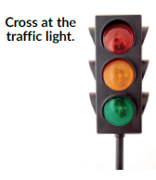
Have you ever travelled to a new city?
Did you ever get lost?
What would you do if you got lost?
Textbook, p. 92.
Listen to Dario’s directions and trace them on the map.
Read the sentences below the pictures. What do they mean?
Cross the road at the zebra crossing. =
Turn right. =
Turn left. =
Go along the street. =
Cross at the traffic light. =
Excuse me, =
Thank you! =
Prijeđi cestu na pješačkom prijelazu.
Skreni desno.
Skreni lijevo.
Idi niz ulicu.
Prijeđi cestu na semaforu.
Oprosti. / Oprostite.
Hvala!

Slide 11
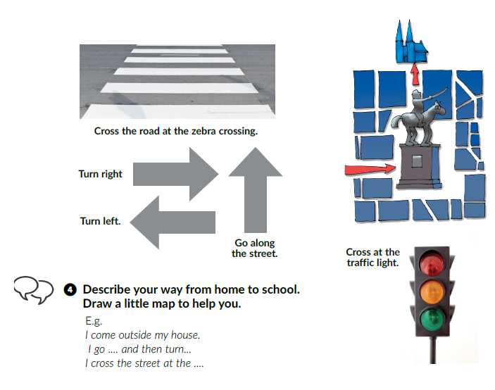
Work in pairs.
Use Google Maps and choose a destination (London, New York, Osijek, Split, Zagreb…). Practise giving directions.

